Slide 1

DESIGN THINKING AND INNOVATION
BUSINESS STRATEGIES, AND BUSINESS MODELS
Dr V. Ramakrishna
Professor, Civil Engineering Department
Lakireddy Bali Reddy College of Engineering (A), Mylavaram

Slide 2
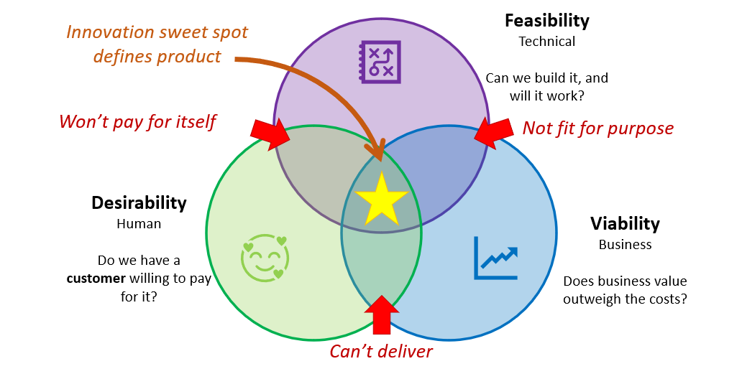
Elements of Design Thinking
Innovation/Outcome

Slide 3
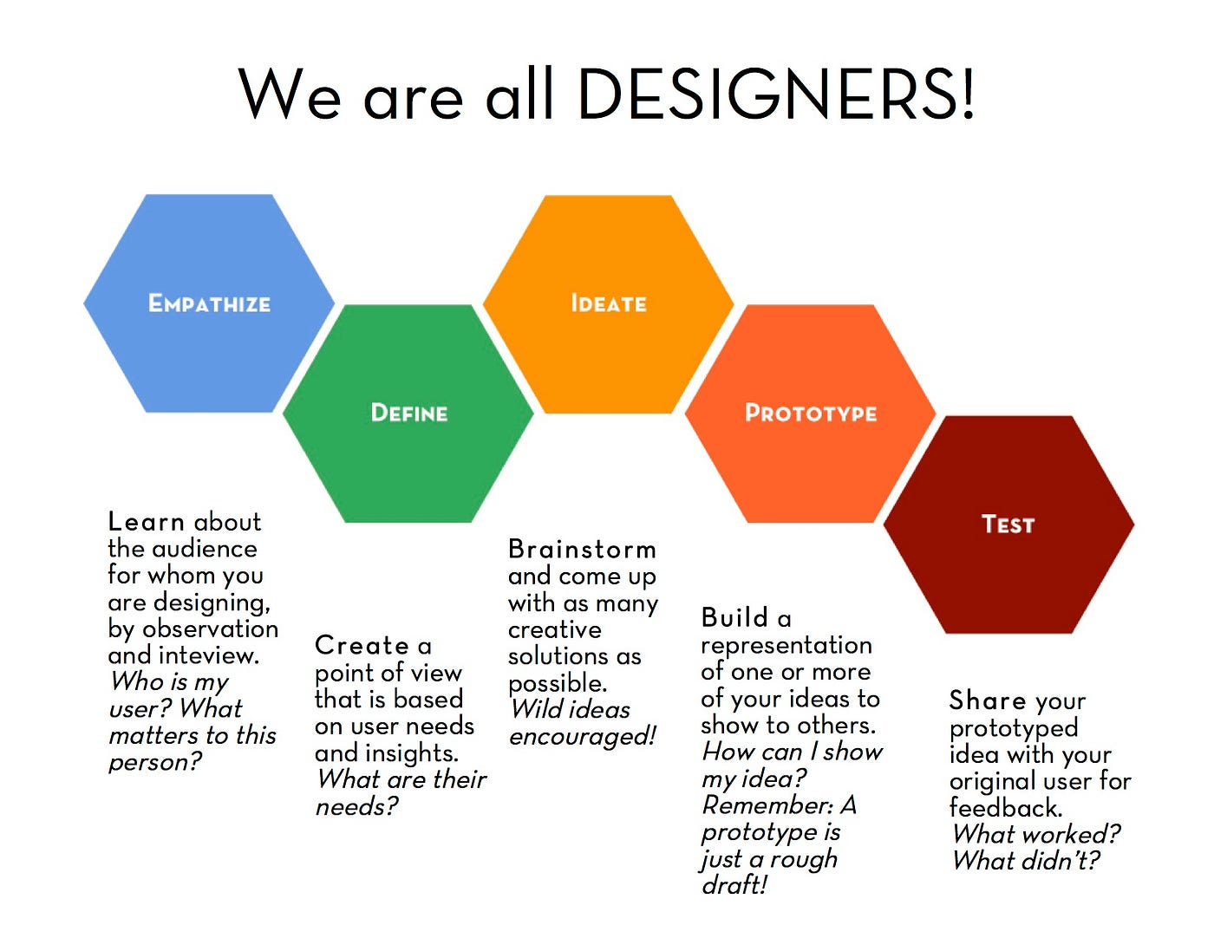
Elements of Design Thinking
INSIGHTS
NEEDS
CONCEPTS
MODELS
REFINE

Slide 4
Design Thinking in Business Innovation
Design Thinking helps in understanding customer needs and solving complex problems in an user-centric manner
Integrating Design thinking in Business enhances customer experiences, drives innovation, fosters collaboration, increased organizational agility, and sustained competitive advantage
Benefits derived:
Enhanced User experience
Increased innovation
Agility and adaptability
Collaboration and Teamwork
Risk mitigation
Strategic alignment

Slide 5
Implementing Design Thinking in Business Strategy
Companies should focus on understanding user needs, fostering collaborations across teams, and encouraging rapid prototyping and testing
Aligning these efforts with overall business goals ensures to drive innovation while supporting long-term growth and adaptability
Functional Steps
Start small: Begin with a pilot project applying Design Thinking principles to solve a specific problem
Encourage Cross-functional teams: Include diverse members from different departments to bring varied perspectives to the table
Empower Employees: Train employees on Design Thinking methodologies and give them the autonomy to explore creative solutions
Leverage Customer feedback: Regularly gather insights from customers to refine products and services continually
Measure Impact: Track the success of Design Thinking initiatives through metrics like customer satisfaction, time-to-market and revenue growth

Slide 6
Principles of Design Thinking in Strategic Innovation
Customer Centricity
Iterative Development
Cross-Disciplinary Collaboration
Customer Centricity: Design Thinking emphasizes deep empathy for the user’s needs ensuring that products, services, and strategies are tailored to real customer issues
Iterative Development: Strategic innovation requires flexibility. By iteratively testing and refining ideas through prototyping and feedback, organizations reduce the risk of failure
Cross-Disciplinary Collaboration: Design Thinking brings diverse perspectives, enabling creative solutions that blend insights from various fields within an organization such as marketing, engineering, and customer service

Slide 7
Benefits of Design Thinking in Strategic Innovation
Better Market Fit: Deep empathy for the user ensures solutions are aligned with actual market needs, leading to improved customer satisfaction and loyalty
Accelerated Innovation Cycle: The iterative nature of Design Thinking reduces time-to-market by identifying issues early in the development cycle, allowing quick adjustments
Improved Risk Management: Prototyping and testing ideas minimizes the chance of costly errors in full-scale implementation, allowing for better resource allocation
Increased Creativity and Adaptability: Design Thinking nurtures a culture of innovation by encouraging continuous learning and adaptability, making it easier for organizations to respond to changes in the competitive landscape

Slide 8
Business Challenges
Organizations face various challenges that test their capability, resilience and innovation. There are different challenges faced by the Industry
Scaling Operations
Talent Acquisition
Financial Resources
Managing uncertainty
Forecasting Limitations
Risk Management
Growth
Predictability
Adapting to Trends
Regulatory Shifts
Technological Advancements
Brand Innovation
Customer Loyalty
Value Preposition
Business Challenges
Maintaining Relevance
Change
Price wars
Market Saturation
Differentiation
Process Consistency
Quality Control
Compliance
Extreme Competition
Standardization

Slide 9
Design Thinking in Predicting Business Challenges
S No | Approach | Description
1 | Empathy | Empathy with users and stakeholders allows businesses anticipate challenges before they emerge by identifying unmet needs
2 | Proactive Problem identification | Thorough examination through Customer Journey maps uncover important and sensitive problems. This insight can help to take proactive steps and reduce gaps, predicting customer behavior changes etc.
3 | Flexibility and adaptability | Design thinking approach helps in encouraging adaptability and make continuous improvements. This is essential to responding and predicting challenges and make improvements
4 | Culture of Experimentation | By testing ideas and solutions at an early stage, businesses can identify the potential roadblocks and adapt their strategies accordingly
5 | Better Decision making | The into problem-solving process cross-functional collaboration adopted helps in bringing diverse perspectives which leads to improved decision making
6 | Alignment with Customer Trends and Market needs | Through regular customer feedback and research, the real time insights obtained are aligned with the changing trends and market shifts for better reach of customers

Slide 10
Business Models
A business model is a strategic plan of how a company will make money.
The model describes the way a business will take its product, offer it to the market, and drive sales
Example of Business Models
Consider the vast portfolio of Microsoft. Over the past several decades, the company has expanded its product line across digital services, software, gaming, and more. Various business models, all within Microsoft, include but are not limited to:
Productivity and business processes: Microsoft offers subscriptions to Office products and LinkedIn. These subscriptions may be based on product usage (i.e. the amount of data being uploaded to SharePoint).
Intelligent cloud: Microsoft offers server products and cloud services for a subscription.
Personal computing: Microsoft sells the Windows operating system as well as physically manufactured products such as Surface, PC components, and Xbox hardware. Residual Xbox sales include content, services, subscriptions, royalties, and advertising revenue

Slide 11
Components of Business Models
A business model is a strategic plan of how a company will make money.
The model describes the way a business will take its product, offer it to the market, and drive sales
S No | Component | Description
1 | Value Proposition | It defines why a customer should choose one product or service or others. A compelling value proposition clearly articulates benefits, unique features and differentiators
2 | Customer Segments | Identifying specific groups of customers who will benefit from the product or service is critical. Understanding the demographics, preferences, and behaviors of these segments allows for targeted marketing and tailored offerings
3 | Revenue streams | It outlines how the business generates income such as direct sales, subscriptions, licensing, advertising etc.
4 | Cost structure | Understanding the costs associated with running the business including fixed and variable costs, is crucial. It helps identify key expenses and potential areas for cost reduction.
5 | Key Resources | Resources that will deliver at the end such as human resources, technology, intellectual property and physical assets are covered.

Slide 12
Components of Business Models
A business model is a strategic plan of how a company will make money.
The model describes the way a business will take its product, offer it to the market, and drive sales
S No | Component | Description
6 | Key activities | This refers to the essential actions and processes required to deliver the value proposition, reach customers, and maintain customer relationships.
7 | Channels | The avenues both offline and online, through which the company delivers its value proposition to customers. Channels may include physical stores, e-commerce platforms, social media and distribution partnerships
8 | Customer Relationships | Understanding how to engage with customers and build loyalty is vital. This can range from personalized service and community engagement to automated support systems
9 | Key Partnerships | Collaborations with suppliers, distributors, and strategic partners can enhance the business model. Partnerships can provide access to resources, technology or markets that may be challenging to achieve independently

Slide 13
Testing of Business Models
A business model is a strategic plan of how a company will make money.
The model describes the way a business will take its product, offer it to the market, and drive sales
S No | Component | Description
1 | Market Research | Conducting surveys, focus groups, and interview with potential customers help gather insights into their needs, preferences and willingness to pay. This data helps to make adjustments to value proposition and overall model
2 | Pilot Programs and MVPs | Creating Minimum Value Products (MVPs) allows startups to test their concepts in the market with minimal investment. MVPs are simplified versions of the product that include just enough features to meet initial customer needs
3 | Feedback Loops | Regularly soliciting feedback from users enables continuous improvement. This can be done through surveys, user testing sessions, and analytics to assess how customers interact with the product
4 | Metrics and KPIs | Establishing Key Performance Indicators helps measure the success of business model. Metrics can include customer acquisition cost, lifetime value, churn rate, and conversion rates providing actionable insights
5 | Iteration | Based on feedback and performance data, businesses should be prepared to iterate on their model for refining the value proposition, adjusting the price etc.

Slide 14

Process of Developing and Testing the Business Models
Assume a smart watch with integrated AI features for health monitoring is designed and a business model is to be developed.
Step-1: Outline the ideas through Business Canvas Map
Step-2: Identify the key partners including manufacturers, software developers and health advisors
Step-3: Identify the possible revenue streams and channels, both offline and online
Step-4: Decide to ensure the users require it and buy it
Step-5: Conduct Empathy based interviews for the insights of customers and health awareness
Step-6: Analyze the data – how many are willing to buy or subscribe, ceiling price etc.
Step-7: Adjust the Business model to suit the data
Step-8: Develop strategies for the investors, about the highlights of the product
Step-9: Test the prototype and take the initial feedback
Step-10: Analyze the feedback
Step-11: Highlight the success stories of prototype advantages through physical models and social media
Step-12: Attract the investors with all the information and make them convinced
Step-13: Launch the product successfully
Step-14: Collect the continuous feedback and upgrade the versions of the product for customer acceptance

Slide 15


Business Strategy, Challenges and Business Model - Activity
Activity
Students should identify a problem for Business development
any household accessories eg. TV, AC, Washing machine, smart watch, smart phone etc.,
or automobiles eg. Scooter, Bike, Car etc.
or any other
Identify and list out the Challenges anticipated in their Business
Develop their own Business strategies, and the Business Model
Illustrate the steps undertaken in the process

Slide 16


